Slide 1
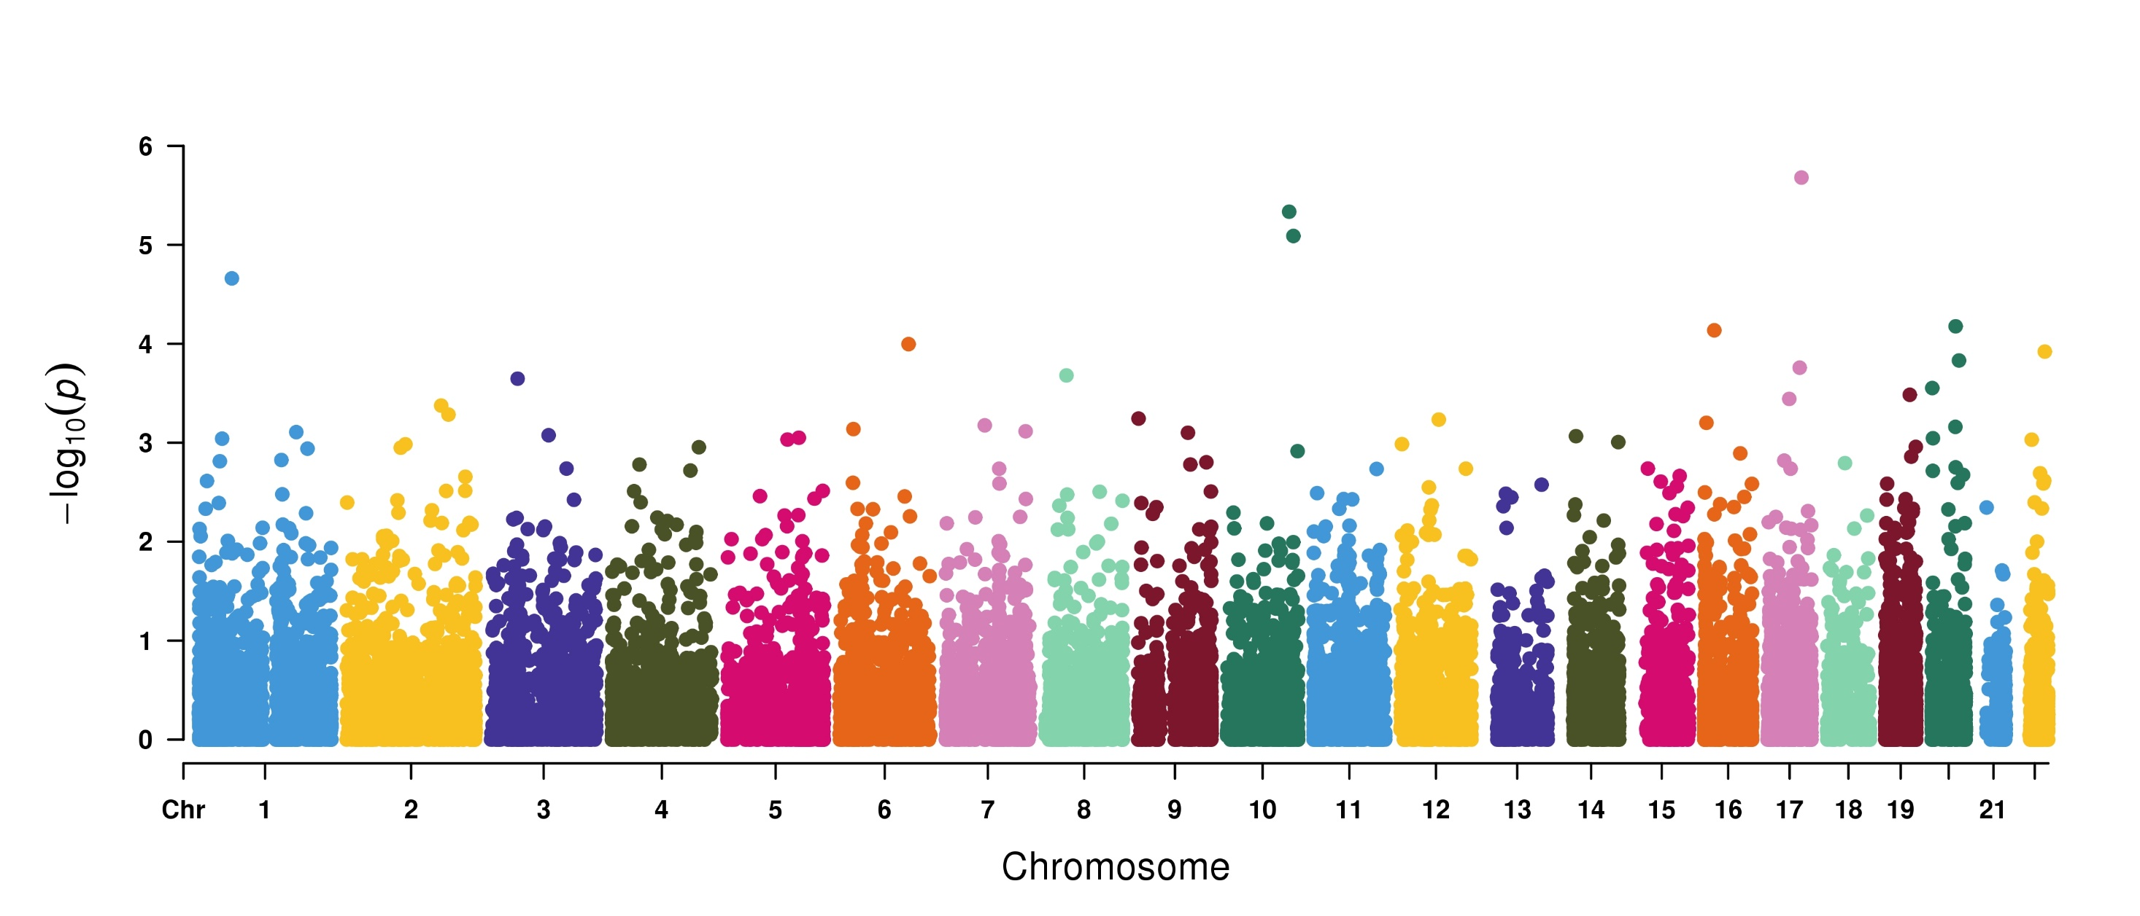
Genome-wide Robust SKAT-O based association study to identify Benign Neoplasm of Colon associated genes in 50K UKBB exome-sequencing data
CCDC47
PNLIPRP2
KANK4
FAM53B
L3MBTL3
TMC7
KCNS1
SEMA3F
ADAM32
C17orf64
2,257 cases and 43,090 controls

